Slide 1
COMP 110/L Lecture 7
Maryam Jalali Some slides adapted from Dr. Kyle Dewey

Slide 2
Outline
Introduction to objects
Constructors and new
Instance variables
Instance methods
static vs. non-static

Slide 3
Object-Oriented Programming

Slide 4

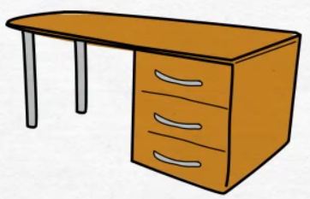





What is an Object?
Notes:
Real-world objects

Slide 5
On the most fundamental level, the way we represent these objects and how we use them is defined in the classes. These classes are blueprints for the objects that we want to create.

Slide 6
Real-world objects has 2 characteristics
1 - State
2 – Behavior
(Something the dog does)
int Breed
String Age
String Color
Bark()
Variables (Fields)
Methods (Functions)
Notes:
Real-world objects

Slide 7
Object Oriented Programming
From this class blueprint we can create several different type of dogs.
Dog A
Dog B
Breed: “German Shepherd”
Age: 3
Color: Brown
Breed: “Golden Retriever”
Age: 5
Color: Yellow

Slide 8
Dog A and Dog B: Instances of Dog
Dog A and Dog B have a breed, age, and color, but the value of theses different attributes are different.
Each dog can call the bark method
Dog A and Dog B are instances of the Dog class

Slide 9
Example
Class: Human Object: Man, Woman, Child
Class Fruit Object: Apple, Banana, Mango
Class: Mobile Phone Object: iPhone, X Samsung S10
Class: Food Object: Pizza, Burger, Rice
Notes:
Class -> Category (general word)
Object -> type of, kind of and …

Slide 10
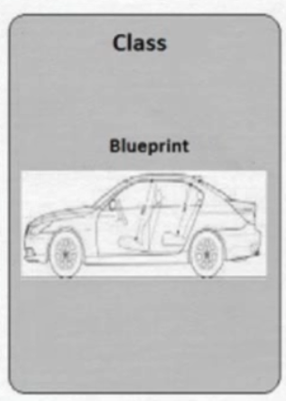
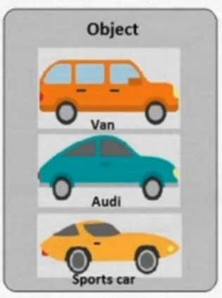
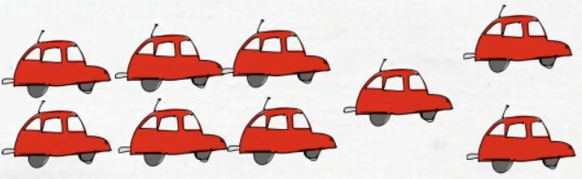
What is Class?
A class is the blueprint which individual objects are created.
Allows you to define your own “user-defined” object.
Notes:
Real-world objects

Slide 11
In real-world car is an object and will have 2 characteristics.
1 - State
2 - Behavior
Size
Color
Make
Model
Move
Accelerate
Turn
Reverse
Shift
Variables (Fields)
Methods (Functions)
Notes:
Real-world objects

Slide 12
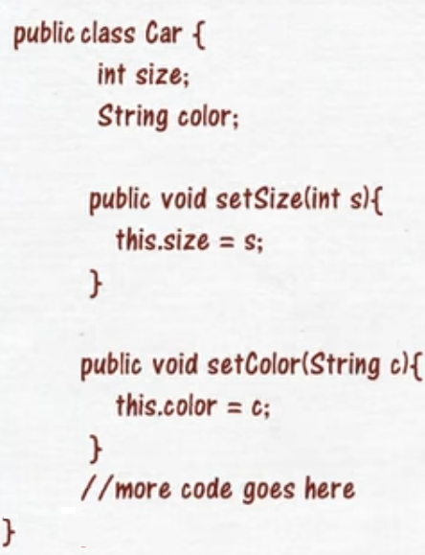
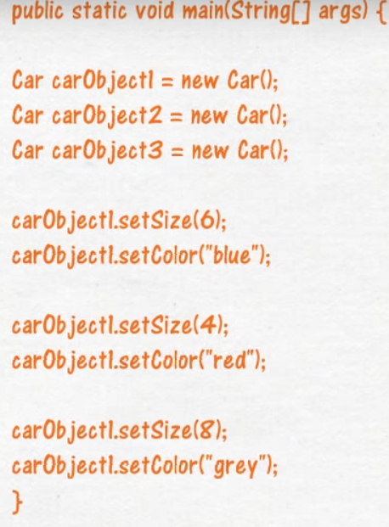
In Programming
Variables (state)
Methods (behavior)
Notes:
Real-world objects

Slide 13
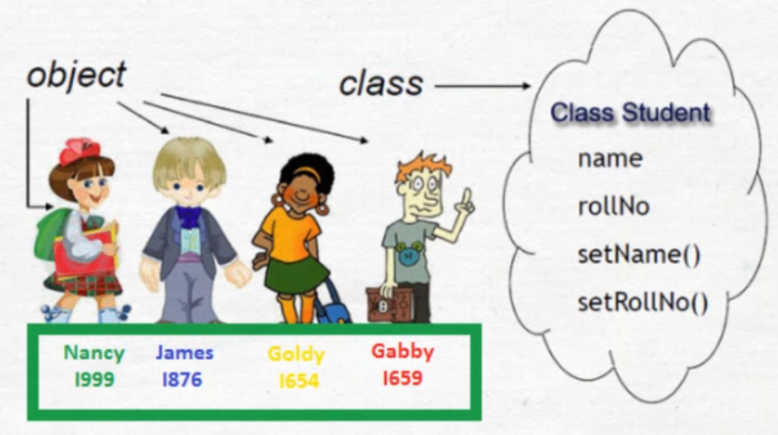
Example
Notes:
Real-world objects

Slide 14
Basic Idea
The world is composed of objects
which interact with each other in well-defined ways
Example: Student
String firstName
String lastName
double gpa

Slide 15
Class Definition
public class Student {
String firstName;
String lastName;
double gpa;
public String toString() {
return lastName+ " , " + firstName;
}
}

Slide 16
Class Definition
public class Student {
}
fields
methods

Slide 17
Basic Idea
The world is composed of objects
which interact with each other in well-defined ways
Example: boiling water
Notes:
-Task: boil water

Slide 18

Basic Idea
The world is composed of objects
which interact with each other in well-defined ways
Example: boiling water
faucet object
Notes:
-I have a faucet object...

Slide 19

Basic Idea
The world is composed of objects
which interact with each other in well-defined ways
Example: boiling water
faucet object
pot object
Notes:
-...as well as a pot object

Slide 20
Basic Idea
The world is composed of objects
which interact with each other in well-defined ways
Example: boiling water
Interaction: fill with water
faucet object
pot object
Notes:
-The faucet can fill the pot

Slide 21

Basic Idea
The world is composed of objects
which interact with each other in well-defined ways
Example: boiling water
Interaction: fill with water
faucet object
pot object
Notes:
-Now the pot is filled with water

Slide 22
Basic Idea
The world is composed of objects
which interact with each other in well-defined ways
Example: boiling water
pot object
Notes:
-Now the pot is filled with water

Slide 23

Basic Idea
The world is composed of objects
which interact with each other in well-defined ways
Example: boiling water Interaction:
Place on top of
pot object
stove object

Slide 24
Basic Idea
The world is composed of objects
which interact with each other in well-defined ways
Example: boiling water
stove object
Notes:
-The pot is now on top of the stove

Slide 25
Basic Idea
The world is composed of objects
which interact with each other in well-defined ways
Example: boiling water
Interaction:
Turn on burner
stove object
Notes:
-Self-interactions are permitted, and even common
Java is a class-based object-oriented programming language, meaning that it facilitates
the creation of objects through the use of classes. Classes are essentially \blueprints"
for creating instances of objects. We've been implicitly using classes all along since
everything in Java is a class or belongs to a class.

Slide 26
Creating Objects
In Java, we first need a class to make an object.
A class serves as a blueprint/template for an object.

Slide 27
Creating Objects
In Java, we first need a class to make an object.
A class serves as a blueprint/template for an object.
Stove Class

Slide 28

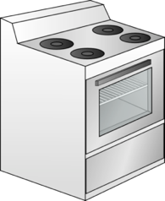
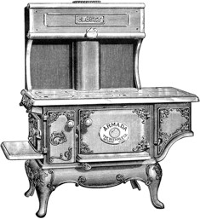
Creating Objects
In Java, we first need a class to make an object.
A class serves as a blueprint/template for an object.
Stove Class
Stove object Stove object Stove object
-The same class can be used to make different stoves
-These stoves can be different from each other, perhaps even radically different. It all depends on exactly how the class is defined.

Slide 29
public class
Declares a class, and gives it
public visibility (more on that later in the course)
Notes:
-This should sound familiar - you’ve been using it this whole time!

Slide 30
public class
Declares a class, and gives it
public visibility (more on that later in the course)
public class Table {
...
}

Slide 31
Constructors

Slide 32
Constructors
A way to initialize the object's member variables.
Code executed upon object creation
Effectively create the object
Looks like a method, but no return type (not even void) and has the same name as the class
Notes:
Student s; //This is not an instance yet, like just saying int x; What values does x have now?
So how we create student? How do we create a user defined data type? It is through constructors
A constructor always returns an instance of the class it is in.
We don't have to state it in the definition of the method because it's already built into Java to expect that behavior

Slide 33
Constructors
Code executed upon object creation
Effectively create the object
Looks like a method, but no return type (not even void) and has the same name as the class
public class Table { public Table() {
System.out.println( “Creating table...”);
}
}

Slide 34
Constructors
Code executed upon object creation
Effectively create the object
Looks like a method, but no return type (not even void) and has the same name as the class
Constructor
public class Table { public Table() {
System.out.println( “Creating table...”);
}
}

Slide 35
Executing Constructors
new executes a given constructor, creating a new object in the process.

Slide 36
Executing Constructors
new executes a given constructor, creating a new object in the process.
Table t = new Table();

Slide 37
Example:
Table.java

Slide 38
Constructor Parameters
Just like methods, constructors can take parameters

Slide 39
Constructor Parameters
Just like methods, constructors can take parameters
public class ConsParam {
public ConsParam(String str) { System.out.println(str);
}
}

Slide 40
Constructor Parameters
Just like methods, constructors can take parameters
public class ConsParam {
public ConsParam(String str) { System.out.println(str);
}
}
ConsParam p = new ConsParam(“hi”);

Slide 41
Example:
ConsParam.java

Slide 42
Instance Variables

Slide 43
Instance Variables
Declared in the class.
Each object created from a class (hereafter referred to as an instance) has its own instance variables.

Slide 44
Instance Variables
Declared in the class.
Each object created from a class (hereafter referred to as an instance) has its own instance variables.
public int | class myInt; | HasInstance // instance | { variable
...
}

Slide 45
Instance Variables
Declared in the class.
Each object created from a class (hereafter referred to as an instance) has its own instance variables.
public class HasInstance {
int myInt; // instance variable public HasInstance(int setInt) {
myInt = setInt;
}
}

Slide 46
public class HasInstance {
int myInt; // instance variable public HasInstance(int setInt) {
myInt = setInt;
}
}
Notes:
-Shift up the code to make some room

Slide 47
public class HasInstance {
int myInt; // instance variable public HasInstance(int setInt) {
myInt = setInt;
}
}
HasInstance a = new HasInstance(7);
Notes:
-Later on you execute this statement...

Slide 48
public class HasInstance { int myInt; // instance variable public HasInstance(int setInt) {
myInt = | setInt;
}
}
HasInstance | a = new | HasInstance(7);
HasInstance | b = new | HasInstance(8);
Notes:
-Followed by this statement...

Slide 49


public class HasInstance { int myInt; // instance variable public HasInstance(int setInt) {
myInt = | setInt;
}
}
HasInstance | a = new | HasInstance(7);
HasInstance | b = new | HasInstance(8);
HasInstance myInt: 7 | a:
Notes:
-In memory, you’d see that a has its own value of myInt, and that is 7

Slide 50


public class HasInstance { int myInt; // instance variable public HasInstance(int setInt) {
myInt = | setInt;
}
}
HasInstance | a = new | HasInstance(7);
HasInstance | b = new | HasInstance(8);
HasInstance myInt: 7 | a: | HasInstance b: myInt: 8
Notes:
-Similarly, b has its own value of myInt, and that is 8
-Key point: while there is one class, there have been two objects made from this class, and each object has its own values for the instance variable.
The instance variables belong to the objects, not the class.

Slide 51
Example:
HasInstance.java

Slide 52
Instance Methods

Slide 53
Instance Methods
Define which interactions can occur between objects
Declared in the class
Specific to objects created from the class (instances), and operate over instance variables.

Slide 54
public class HasInstance {
int myInt; // instance variable public HasInstance(int setInt) {
myInt = setInt;
}
}
-To show an example, let’s take the HasInstance definition from before...

Slide 55
public class HasInstance2 {
int myInt; // instance variable public HasInstance2(int setInt) {
myInt = setInt;
}
public void printInt() { System.out.println(myInt);
}
}
-...and now we add the printInt instance method
-The name of the class has also been changed, just so we can have both examples in two separate files (namely HasInstance.java and HasInstance2.java)

Slide 56
Example:
HasInstance2.java

Slide 57
static
Associates something with the class itself,
as opposed to individual objects created from the class.
Notes:
We add the keyword static if the function does not use the attributes of a class, but still relates to the overall theme or idea of the class

Slide 58
static
Associates something with the class itself,
as opposed to individual objects created from the class.
public class MyClass { public static void main(String[] args) {
...
}
}
-You’ve been defining main and all your methods this way the entire time
-Java forces all source code to be in classes, so this is unavoidable. However, we haven’t really gotten into proper objects yet.

Slide 59
static vs. non-static
With static: associated with the class.
Without static: associated with objects
created from the class.

Slide 60
static vs. non-static
With static: associated with the class.
Without static: associated with objects
created from the class.
public class MyClass { public static void main(String[] args) {
...
}
}

Slide 61
static vs. non-static
With static: associated with the class.
Without static: associated with objects
created from the class.
public class MyClass { public static void main(String[] args) {
...
}
}
With class
MyClass

Slide 62
static vs. non-static
With static: associated with the class.
Without static: associated with objects
created from the class.
public class MyClass { public static void main(String[] args) {
...
}
}
With class
MyClass
public class MyClassTest { @Test
public void someTest() {...}
}

Slide 63
static vs. non-static
With static: associated with the class.
Without static: associated with objects
created from the class.
public class MyClass { public static void main(String[] args) {
...
}
}
With class
MyClass
With objects created from MyClassTest public class MyClassTest {
@Test
public void someTest() {...}
}

Slide 64
Stove Example in Java
Water.java
Faucet.java
Pot.java
Stove.java
BoilingWater.java

